Slide 1
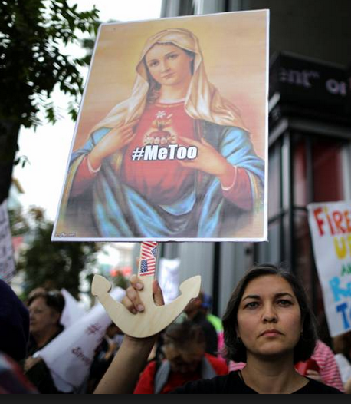
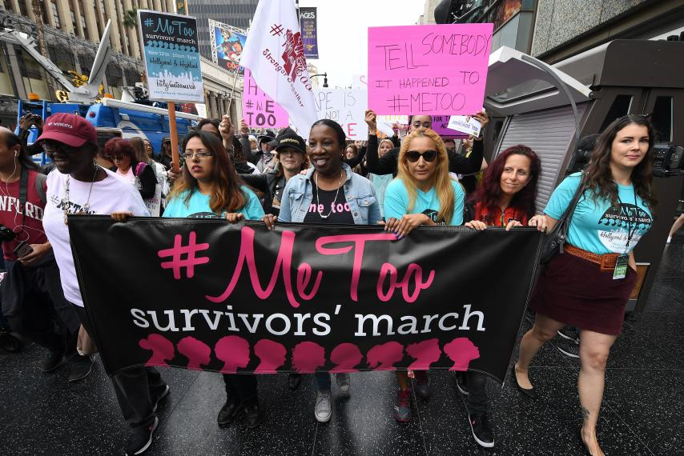
#semiotics
Colin Loughran

Slide 2
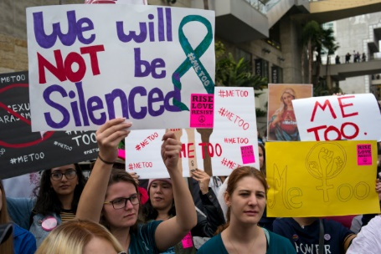
Words can speak for themselves
According to philosopher Roland Barthes, written words are examples of semiotics and used in his system of signifier.
The written words seen on the banners are the obvious display that makes the signifier of the images.
In general, the written words seen is perhaps the most vital to what’s occurring in the images and informs the meaning to the viewer.

Slide 3
Iconic Sign
Since the written words are the signifiers, then the protest movement seen in the image is what is signified.
The written words on the banner: Me Too is the signifier for the group of women together as a group taking a stance.
Another use of signs seen in the image would be the facial expressions of all the women. They all have the same look signifying the bravery and activism seen for this event.

Slide 4
Impact
These iconic signs leaves an emotional influence on its viewer by:
Self awareness for a current conflict
Reassured for not feeling alone
Empowerment for one’s own self
Bravery to stand up for a righteous cause

Slide 5
